Slide 1





World Cup Prediction
with Logistic regression
Elvis Yeboah-Duako
Ms. Computer Science And Technology

Slide 2
Section I
Presentation Outline
Introduction
Mathematical Background
Logistic Regression
Derivation of Logistic Model
Maximum Likelihood Estimation (MLE)
Performance of the Logit Model
Background

Slide 3

Introduction
The world cup is national sporting event organized by FIFA every 4 years.
Competition is made up of 32 countries who make it through various qualification games.
This year’s tournament takes place at Qatar in November
Goal of the Project:
Use of regression analysis (a numerical analysis technique) to predict the country that wins this year’s FIFA world cup tournament at Qatar.
Note:
Guess the country that will win in the chat box ☺
Winner(s) gets a dollar from me. ☺ ☺

Slide 4
Mathematical Background
Numerical Analysis is the design, analysis and implementation of numerical methods that yield exact or approximate solutions to mathematical problems.
Logistic Regression
Regression is used in establishing relationships between dependent variables ( outcome/response variable or label) and one or more independent variables (predictors/ features/ covariates).
Regression
Analysis
Logistic Regression is a regression model used to model the
Probability of one event (out of two alternatives) taking place.
It is basically a classification algorithm used to predict a
binary outcome given a set if independent variables
Numerical
Analysis

Slide 5
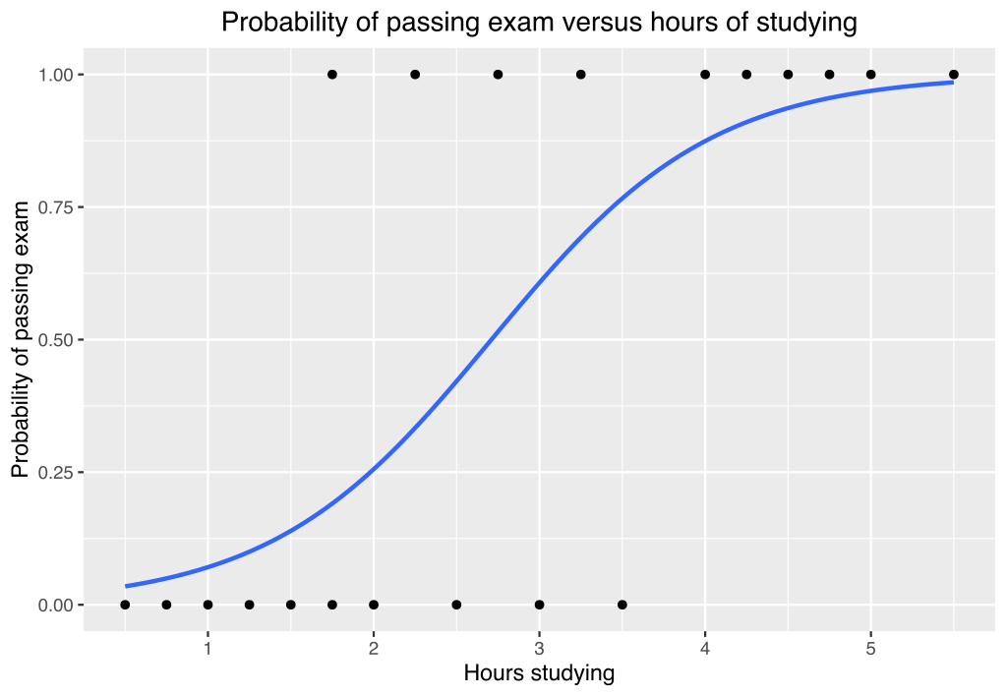
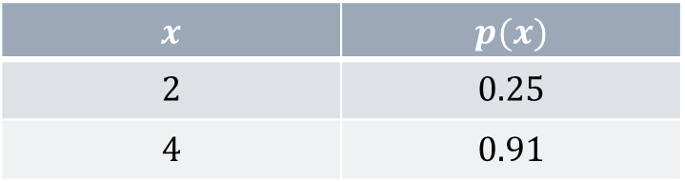
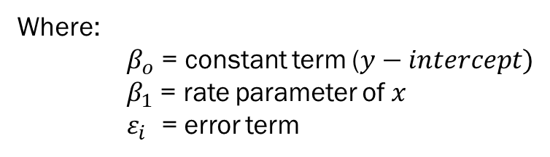
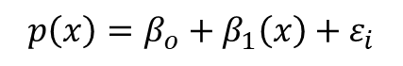

Logistic Regression
Mainly used in determining the probability of the occurrence of a categorical dependent variable based on other correlated independent variables
For instance, Given the data:
Hours(x) | 0.50 | 1.00 | 1.50 | 1.75 | 2.50 | 3.50 | 4.00 | 4.75 | 5.00 | 5.50
Pass(y) | 0 | 0 | 0 | 1 | 0 | 0 | 1 | 1 | 1 | 1
And say we want to find the probability of a student passing an exams based on the number of study hours.
Dependent Variable $p(x)$= Probability of Passing
Independent variable (x) = Number of study hours
$$x$$ | $$p(x)$$
$$2$$ | $$0.25$$
$$4$$ | $$0.91$$
$$p\left(x\right)=β_{o}+β_{1}\left(x\right)+ε_{i}$$
(1)
Where:
$β_{o}$ = constant term ($y−intercept)$
$β_{1}$ = rate parameter of $x$
$ε_{i}$ = error term
Note: For multiple regression model with $i$ features:
$$p\left(x\right)=β_{o}+β_{1}\left(x_{1}\right)+β_{2}\left(x_{2}\right)+…+β_{i}\left(x_{i}\right)+ ε_{i}$$
(2)

Slide 6
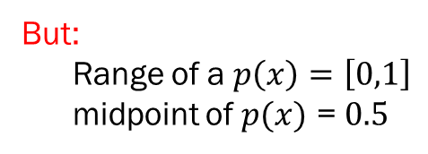
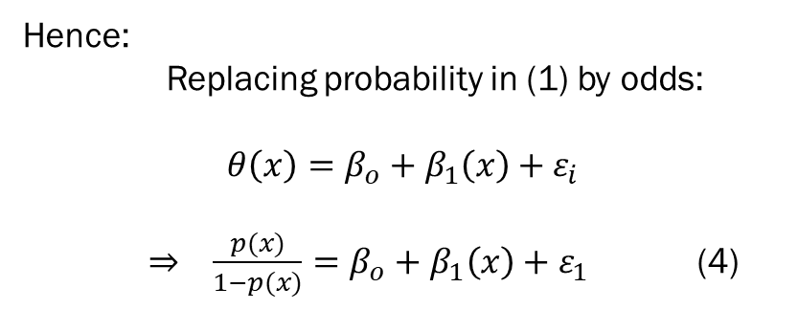
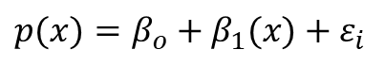
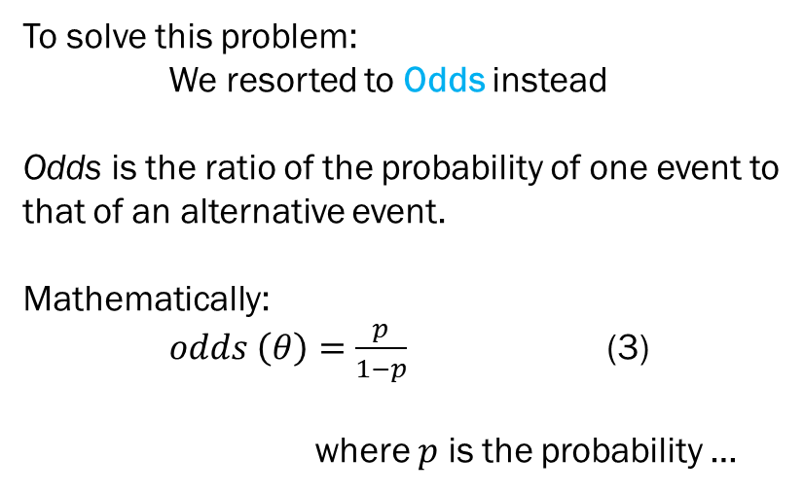
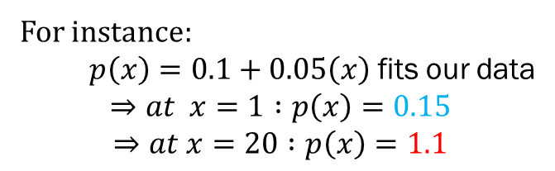

Derivation of Logistic Model
To solve this problem:
We resorted to Odds instead
Odds is the ratio of the probability of one event to
that of an alternative event.
Mathematically:
$odds \left(θ\right)=\frac{p}{1−p}$ (3)
where $p$ is the probability …
Recall Equation (1):
$p(x)=β_{o}+β_{1}(x)$ $+ ε_{i}$
But:
Range of a $p\left(x\right)=\left[0,1\right]$
midpoint of $p(x)$ = $0.5$
What happens when $x →∞$ ?
$p\left(x\right)$ goes out of its limits
Hence:
Replacing probability in (1) by odds:
$$θ\left(x\right)=β_{o}+β_{1}\left(x\right)+ε_{i}$$
$⇒ \frac{p(x)}{1−p(x)}=β_{o}+β_{1}\left(x\right)+ε_{1}$ (4)
For instance:
$p\left(x\right)=0.1+0.05\left(x\right)$ fits our data
$$⇒at x=1 :p\left(x\right)=0.15$$
$$⇒at x=20 :p\left(x\right)=1.1$$

Slide 7
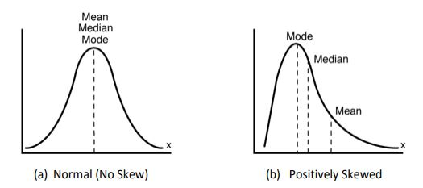
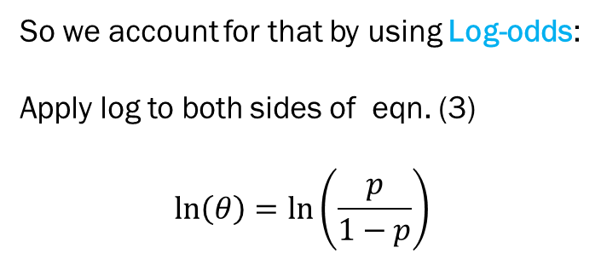
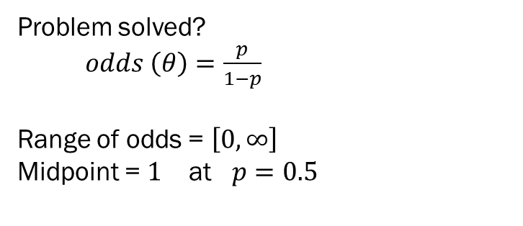

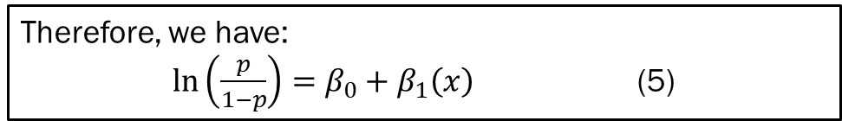
Derivation of Logistic model Cont’d
Problem solved?
$odds \left(θ\right)=\frac{p}{1−p}$
Range of odds = $\left[0,∞\right]$
Midpoint = $1$ at $p=0.5$
So we account for that by using Log-odds:
Apply log to both sides of eqn. (3)
$$\ln\left(θ\right)=\ln\left(\frac{p}{1−p}\right)$$
(3)
Not yet! :
- still a hard lower limit of zero (0)
- distribution is extremely skewed
(positive)
Therefore, we have:
$\ln\left(\frac{p}{1−p}\right)=β_{0}+β_{1}\left(x\right)$ (5)
Range of log-odds = $\left[−∞,∞\right]$
Midpoint = $0$ at $p=0.5$
Great, problems solved!
Equation (5) = General Equation for Binomial Logistic Regression

Slide 8
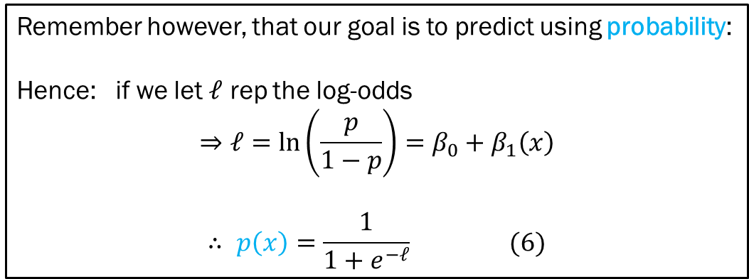
Derivation of Logistic model Cont’d
Remember however, that our goal is to predict using probability:
Hence: if we let $ℓ$ rep the log-odds
$$⇒ℓ=\ln\left(\frac{p}{1−p}\right)=β_{0}+β_{1}\left(x\right)$$
$$∴ p\left(x\right)=\frac{1}{1+e^{−ℓ}} (6)$$

Slide 9
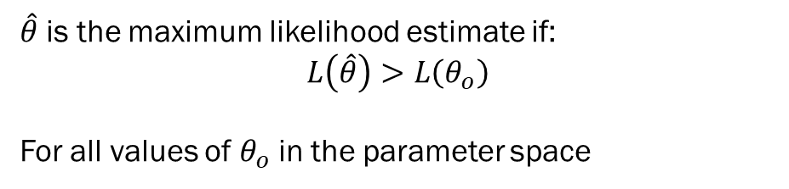
Maximum Likelihood Estimation (MLE)
MLE provides the parameter value(s) that make the observed sample the most likely sample among all possible samples.
(7)
$\hat{θ}$ is the maximum likelihood estimate if:
$$L\left(\hat{θ}\right)>L\left(θ_{o}\right)$$
For all values of $θ_{o}$ in the parameter space

Slide 10
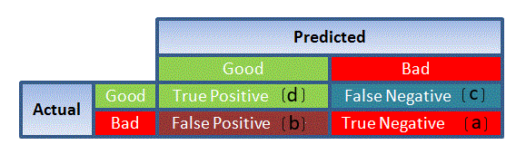
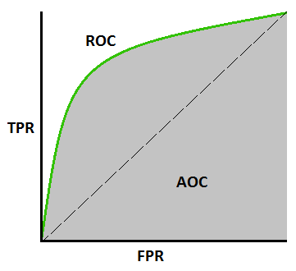
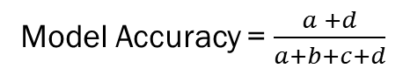
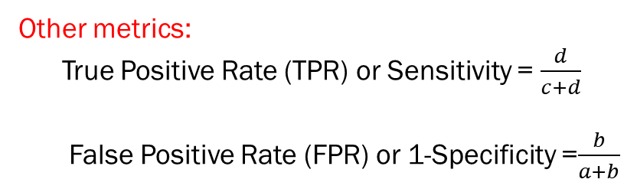
Performance of Logistic Regression Models
1. Confusion Matrix
It’s a tabular representation of actual vs predicted values.
It helps to determine the accuracy of the model and to also
Avoid overfitting.
2. Receiver Operating Characteristic (ROC) Curve
Summarizes the model’s performance by evaluating the trade offs between True Positive Rate (Sensitivity) and False Positive Rate (1 - Specificity).
3. Area Under the Curve (AUC)
Is the performance model for ROC curve. The Higher the AUC, the better the prediction power of the model.
Model Accuracy = $\frac{a +d}{a+b+c+d}$
Other metrics:
True Positive Rate (TPR) or Sensitivity = $\frac{d}{c+d}$
False Positive Rate (FPR) or 1-Specificity =$\frac{b}{a+b}$

Slide 11
Section II
Presentation Outline
Methodology
Data Sets
Data Exploration
Feature Extraction
Data Modelling
Training Logit Model
Performance analysis
Simulation & Predictions
Simulation and Prediction

Slide 12
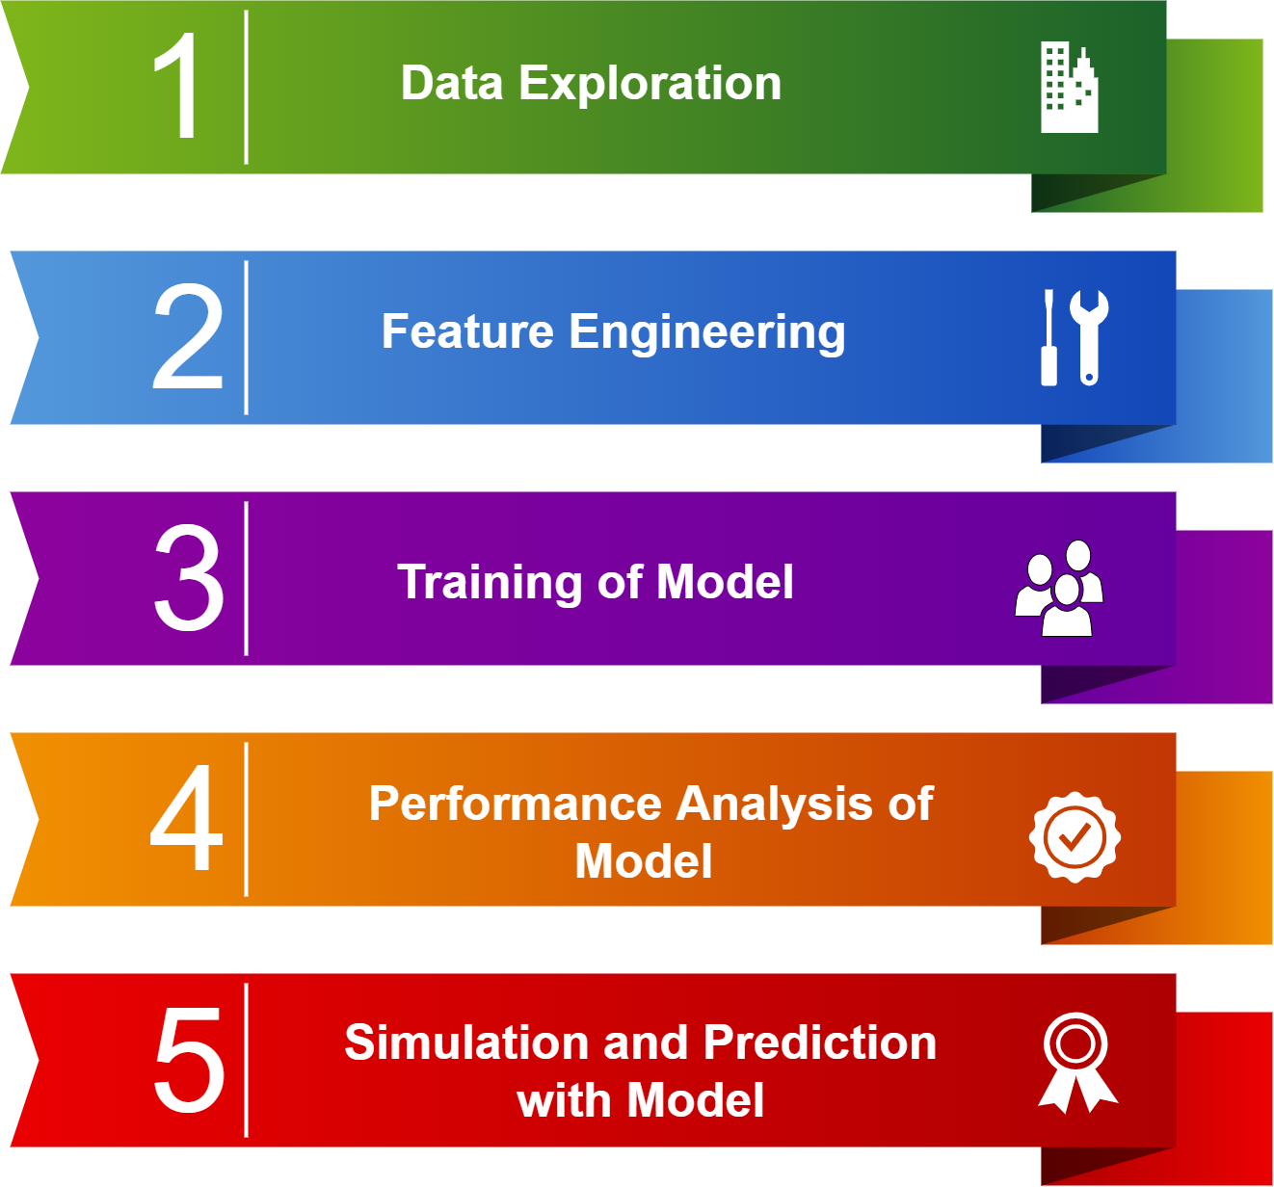
Methodology

Slide 13

Data Sets
1. FIFA Soccer Rankings (August 1993 to April, 2018)
To ascertain team performances over time. Serves as a
decent predictor of team performances.
sample attributes: monthly Ranking, points rank change, etc.
Source: GitHub. Accessible via this link
2. Past International Soccer Matches (1872 to 2018)
To access team strengths against various opponents
sample attributes: scores, tournament type, venue, etc.
Source: Kaggle. Accessible via this link
3. FIFA World Cup 2022 data set
To generate and simulate the impending World Cup
Main attributes: opponents, previous matches, titles won, etc.
Source: Kaggle. Accessible via this link
Note: data here is for FIFA 2018 world cup: But I updated it with the current world cup information

Slide 14
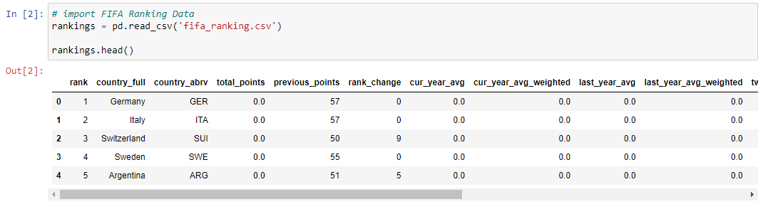
Data Exploration
Overview of the FIFA Ranking dataset: sample Attributes and values

Slide 15
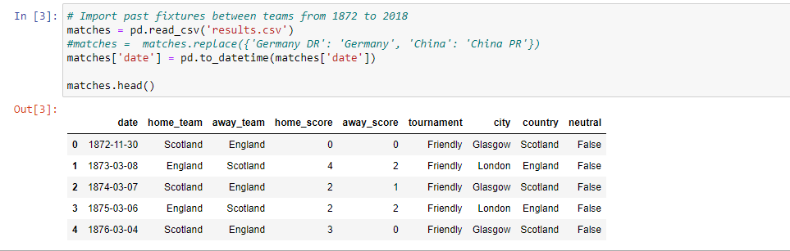
Data Exploration
Overview of the Past matches dataset: sample Attributes and values

Slide 16
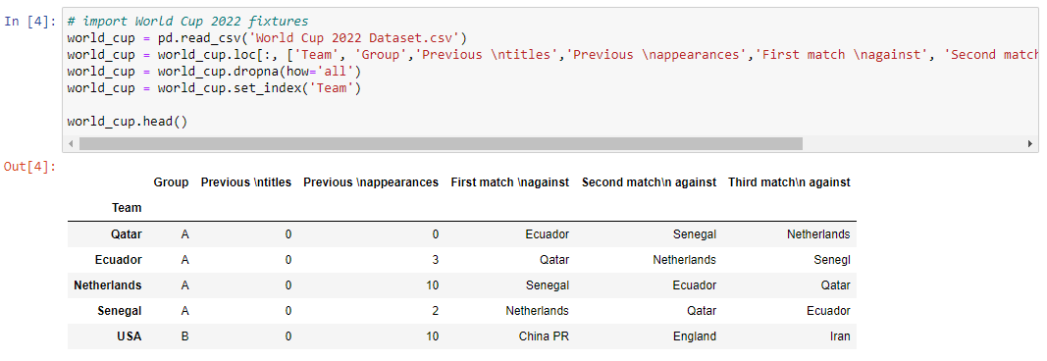
Data Exploration
Overview of the 2022 World cup dataset: sample Attributes and values

Slide 17
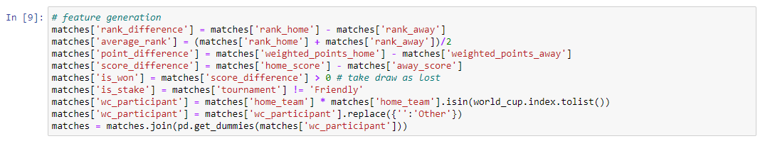
Feature Extraction
Useful Features were extracted from the datasets to be used for modelling as shown below:

Slide 18
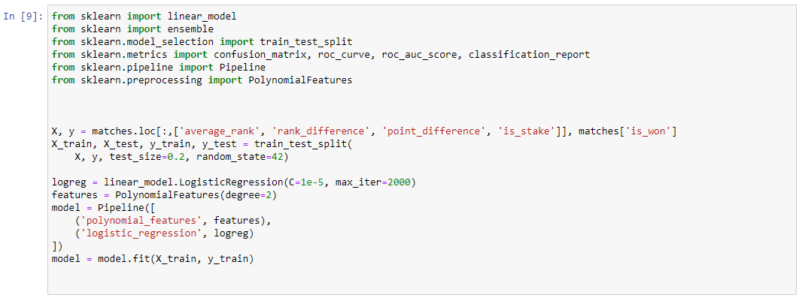
Data Modelling: Training Logit Model

Slide 19
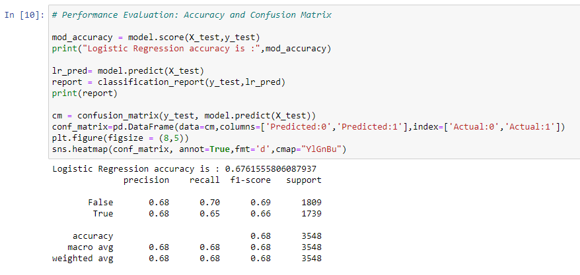
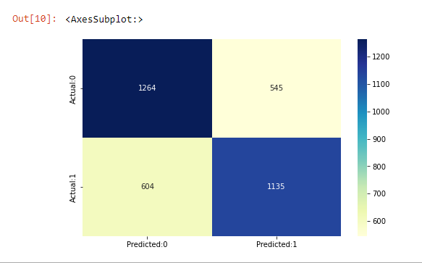
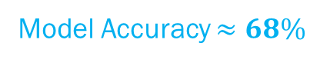
Data Modelling: Performance Analysis
Model Accuracy $≈68\%$
TP FN
FP TN
Confusion Matrix

Slide 20
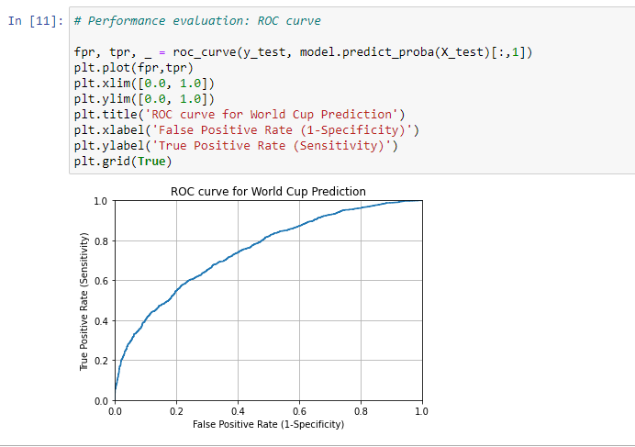
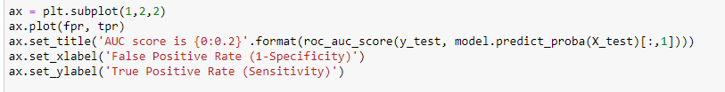
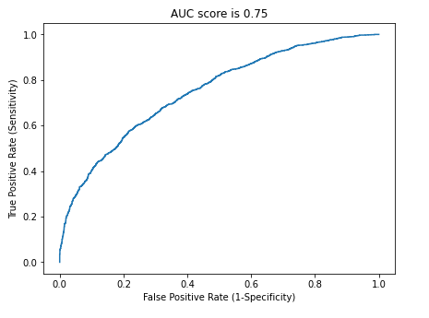

















Data Modelling: Performance Analysis

Slide 21

Simulation – Group Stages

Slide 22
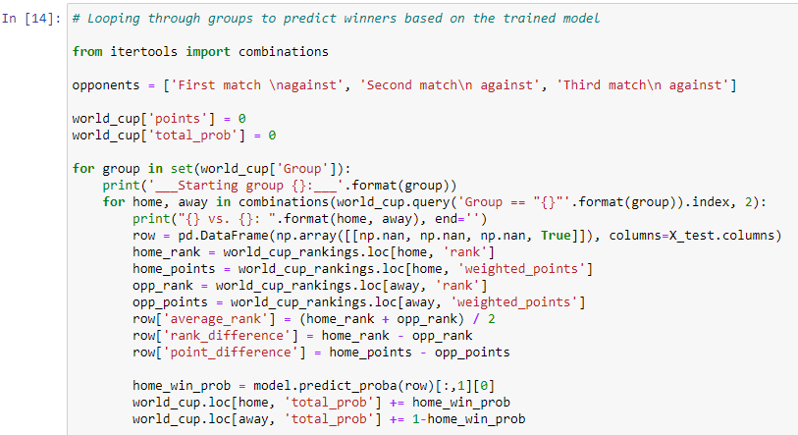
Simulation – Group Stages
Code:

Slide 23
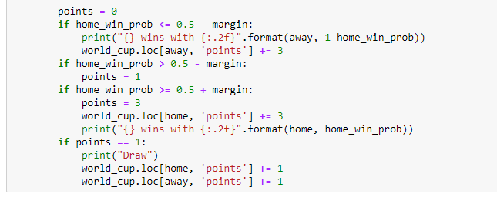
Simulation – Group Stages
Code cont’d:

Slide 24
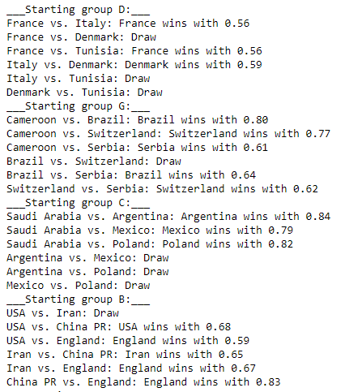
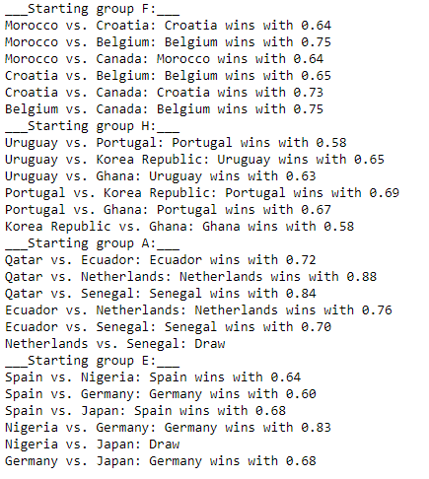
Simulation – Group Stages: Results

Slide 25
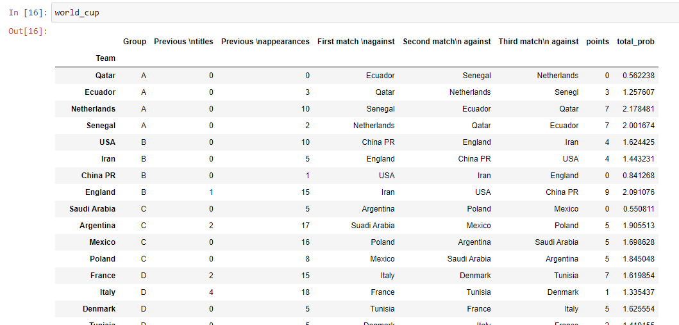
Simulation – Group Table Results

Slide 26
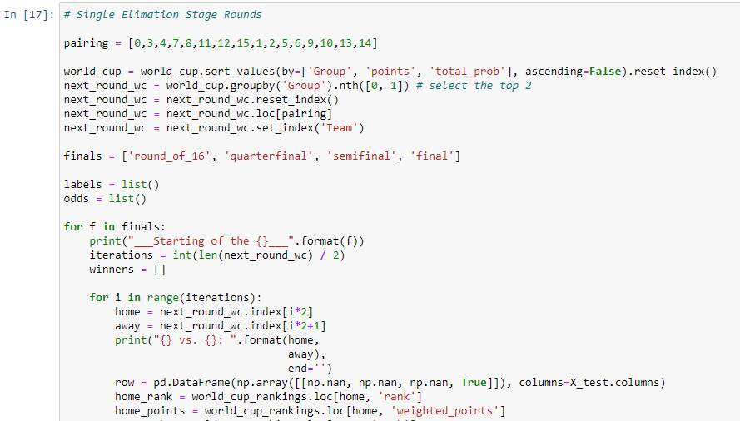
Simulation: Elimination Stages
Code:

Slide 27
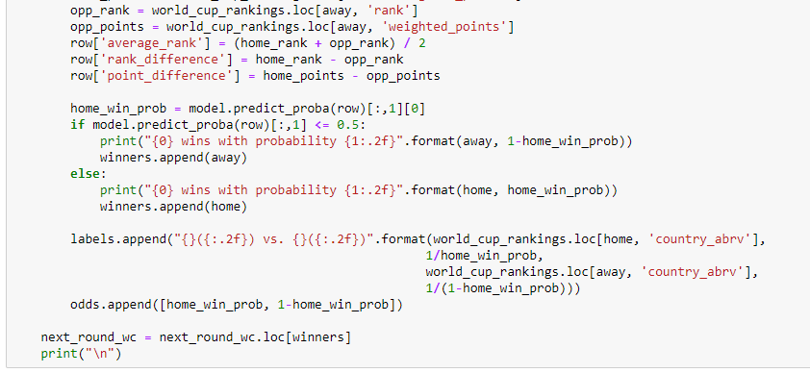
Simulation: Elimination Stages
Code:

Slide 28

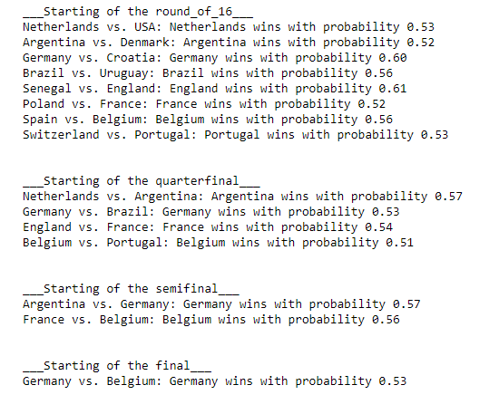

Simulation: Elimination Stages: Results

Slide 29
Conclusion
In this Presentation:
I demonstrated the use of logistic regression in predicting the winner of the world cup by simulating each
individual match with a model accuracy of 68%
Also, I gave a brief explanation on the underlying mathematical model behind Logistic Regression
With further extensive Feature engineering, the accuracy can be enhanced.

Slide 30
Thank you
ELVIS YEBOAH-DUAKO
MS. Computer Science and Technology
School of Computer Science and Engineering

